Slide 1


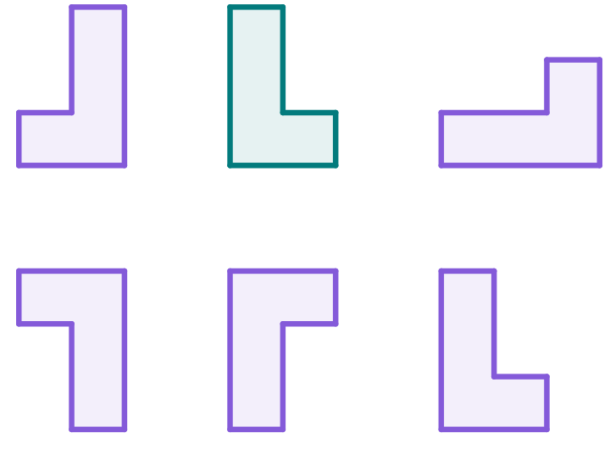
Introduction to reflections
Task A: Understanding properties of reflection
1) In which of these images has the sense changed (due to reflection)?
2) For the non-reflections, state whether they are translations or rotations.
object
ZONE
rotation
translation
rotation
3) In which of these images has the sense changed (having been reflected)?
4) For the non-reflections, state whether they are translations or rotations.
object
rotation
rotation
translation
1

Slide 2
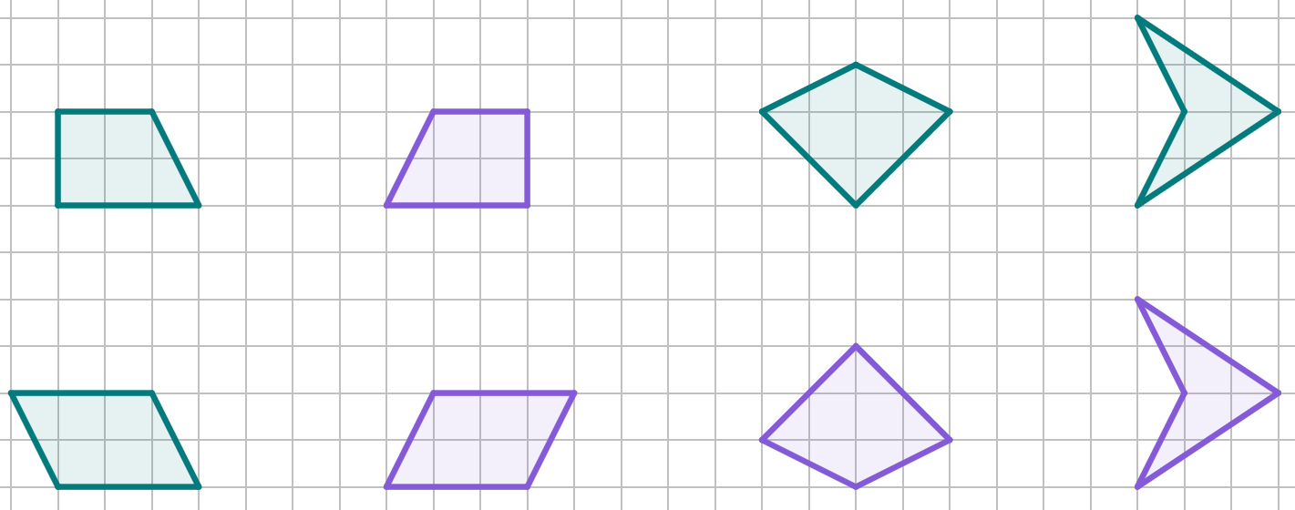

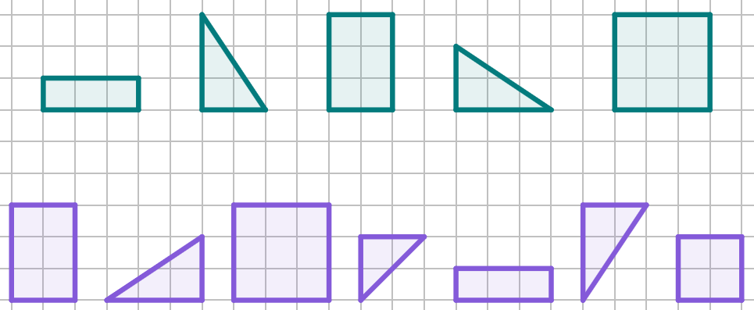

Introduction to reflections
Task B: Understanding properties of reflection
1) Each object has been reflected.
Complete the labelling of the vertices of each image.
M
I
M
I
B
A
A′
B′
B
A
A′
J
L
N
P
J
L
N
P
O
C
D
D′
O
C
D
C′
C′
K
K
K′
O′
F
E
E′
F
E
F′
F′
P′
N′
P′
J′
J′
L′
G
H
H′
G′
M′
G
H
I′
2) Match the objects to their reflections.
There are two images that do not pair with an object.
a
b
c
d
e
objects
c
e
b
images
d
a
f
g
h
i
j
k
l
 | Always Invariant | Usually Changes
Lengths of Sides
Size of Angles
Position |  | Always changes
Orientation |  | Always changes
Sense |  | Always changes
3) Complete the table with to show the properties of reflection.
Mathematics in Education and Industry
2
v2.1

